Slide 1


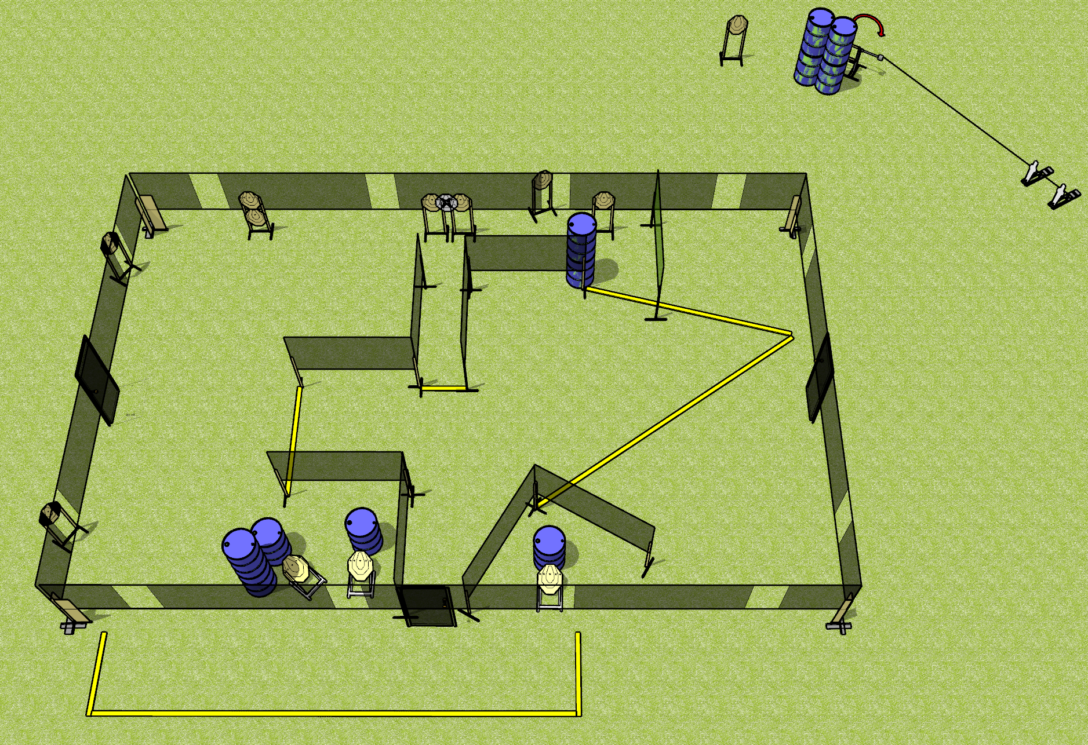
 | Dothan Gun Club – USPSA Match Housing Crisis Course Designer : Drew Coleman Bay: SH
Round Count 28 rounds 13 ISPC 2 mini poppers
Equipment List 2 wall feet Swinger + activator 2 tux 12 targets (11 + 1 NS)

Slide 2
Housing Crisis
Written Stage Briefing
Scoring: Comstock Rounds: 28
Targets: 13 IPSC, 2 steel
Handgun start position: anywhere inside the shooting area, wrists below belt. Handgun is loaded and holstered.
PCC start position: anywhere inside the shooting area, stock on belt. Loaded carbine is held with both hands, safety on.
Stage Procedure: on the audible start signal, engage targets as they become available from within the shooting area. The swinger is activated by either popper and remains visible at rest.

